Slide 1
AngularJS training Day 4
Elias Carlston
DevelopIntelligence
elias@eliascarlston.com

Slide 2
Day 4 Schedule
What’s new in 1.3 and 1.4
Components in Angular 1.5
Angular 2 Introduction
TypeScript and ES6
Components in Angular 2

Slide 3
New in 1.3
one-time bindings
ngAria
ngMessages
ngModelOptions
ng-hint
bindToController

Slide 4
New in 1.3
One-time bindings
<!-- expression will not change once set -->
<h1>{{::title | uppercase}}<h1>

Slide 5
New in 1.3
ngAria (module)
Support common ARIA attributes for users using assistive technologies like screen readers.

Slide 6
New in 1.3
ngMessages (module)
Improves form validation feedback
angular.module("App", ['ngMessages'])
<div ng-messages="myForm.myField.$error">
<div ng-message="required">
You did not enter a field
</div>
<div ng-message="minlength">
The value entered is too short
</div>

Slide 7
New in 1.3
ngModelOptions
Specify how model updates are done
<input
type="text"
ng-model="search"
ng-model-options="{
updateOn: 'default blur',
debounce: {'default': 500, 'blur': 0}
}"
>

Slide 8
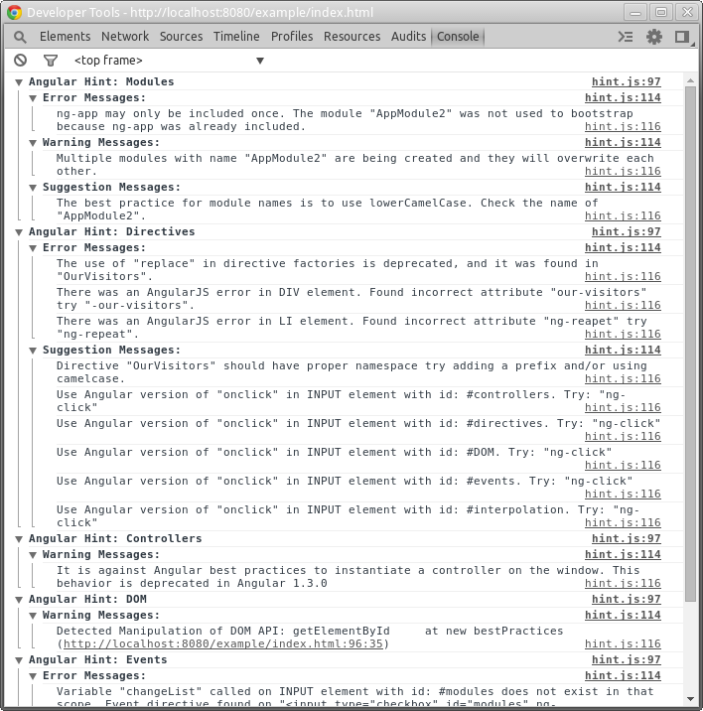
New in 1.3
ngHint
Improve debugging experience
<body ng-app="myApp" ng-hint>

Slide 9
New in 1.3
bindToController
Boolean flag which solves some gnarly problems when using controllerAs in a directive with isolate scope.
This:
controller: function ($scope) {
this.name = 'Pascal';
$scope.$watch('name', function (newValue) {
this.name = newValue;
}.bind(this));
}
Becomes this:
controller: function () {
this.name = 'Pascal';
},
bindToController: true,

Slide 10
New in 1.4
ngAnimate overhaul
New $cookies service
Dynamic ngMessages
Miscellaneous

Slide 11
New in 1.4
ngAnimate overhaul
imperative CSS-based animations
anchoring (cross-animate between views)
use animation callbacks from controllers
promises support
performance enhancements

Slide 12
New in 1.4
New $cookies service
ngCookies module replaces $cookieStore
Configure defaults via $cookiesProvider
$cookies.put('name', 'value', config);
$cookies.putObject('name', 'value', config);
$cookies.remove('name', {path: '/a/b'});
$cookiesProvider.defaults = {
domain: ‘www.mydomain.com’,
secure: true
};

Slide 13
New in 1.4
Dynamic ngMessages
<div ng-repeat="m in messages">
<div ng-message-exp="m.expression">
{{m.description}}
</div>
</div>

Slide 14
New in 1.4
Miscellaneous
ngModelOptions timezone support
angular.merge
bindToController
Changes from boolean to config object
No longer exclusive to isolated scope

Slide 15
Components (1.5)
Transitional step towards nG 2
Components are a subtype of directive representing a complete UI element
Bundles a view, a controller, and bindings in simpler recipe
Default Component options:
restricted to elements
transclude false
Isolate scope
controllerAs $ctrl
Continue to use Directives to add custom behavior to existing elements
Two way bindings are deprecated in 1.5 Components
nG 2 moves away from two way binding
They cause too many issues with parent scope and prevent full separation from DOM
Instead, specify one-way bind for display info
Then register an event handler (onChange, onDelete)

Slide 16
1.5 -> 2 Migration Strategy
Component-based architecture can be implemented using nG1.5 Components
nG1.5 app following component pattern should convert relatively easily
Template syntax conversion is straightforward
Component syntax cant be converted, but design pattern stays comparable
Many functions will be copypasteable, or small tweaks
Services dont change much
<1.5 apps not following component style will require more rewriting

Slide 17
Component Architecture in nG 2
Components have everything they need to be self contained units of code
nG2 apps should be made by composing reusable components into new features
Components consist of...
A component definition object (CDO)
Template
An API to communicate outside (Input and Output props)
Changes
$scope is gone. Store data directly as properties of the CDO
Controllers are gone. CDO coordinates bindings between View and Model

Slide 18
Angular 2
Emphasis
Aligning with HTML5 web components
Simplifyling API – many removals
Browser support
Targets "evergreen" browsers
Some conflicting info online, but looks like support goes back as far as IE9
https://angular.io/docs/ts/latest/guide/browser-support.html
TypeScript
Officially recommended
Documentation is written in TS

Slide 19
Angular 2
Major changes
The central API is now Components
Components are a type of Directive, those are still around
Providers are still around, but their sugar/subtypes have been removed
Large portions of the API have been removed:
angular.module, scope, controllers, filters, ng-app
Greater reliance on dependency injection
nG2 only includes minimum functionality by default
Gotcha: common "undefined" or "not a function" errors when you forget an import
Relatively unchanged
Directives
Providers are still around, but their sugar/subtypes have been removed

Slide 20
Angular 2
Advantages gained
Smaller, more consistent API
Greater modularity/DI - import only what you need means smaller downloads
Greater separation from DOM - testing, IDE support
Performance speedups primarily due to jettisoning digest checking
Aligns closer with the future of web components

Slide 21
Angular 2
A word of caution
nG 2 is officially in beta. What does beta mean?
"we're now confident that most developers can be successful building large applications"
A platform is not just its code though, also its ecosystem
Tooling & 3rd party library support
Documentation
Error handling messages
Community support
IMO, nG2 ecosystem is not mature yet
Official documentation is intentionally complete
Many syntax changes make older articles unreliable
TSC compilation issues
Proceed with caution

Slide 22
TypeScript
From Microsoft, a compiled superset of Javascript
All valid JS is valid TS (theoretically - in practice often requires tweaking)
Adds support for static typing
Specify type when declaring vars, function arguments and return values, etc
Describe custom types with a "declaration" file - describe interface
Adds the common ES6 features
arrow functions, classes, modules, let keyword, Map, Promise
Compatibility table: http://kangax.github.io/compat-table/es6/
And some unique features
@ Decorator syntax (often referred to as annotation)
inline variable type specification
Tutorial: https://johnpapa.net/typescriptpost1/
Quick syntax reference: https://quizlet.com/134674527/typescript-syntax-flash-cards/

Slide 23
New template syntax
No longer markup-based
Use square bracket to bind output: [ngModel]="editingSong.title"
Parenthesis subscribe their target to events: (click)="editSong(index)"
For forms, nest parens inside brackets to two-way bind
Previous format ng-dirname now *ngDirname
New iteration syntax "#eachThing of thingsList; #i = index"
Reasons for the changes
Enables tons of IDE features like autocomplete and refactor
Makes the direction of binding obvious from the markup

Slide 24
Pipes
Pipes aren’t much more than a new name for filters
Async is the exception
Binds to the output of an Observable
More on observables soon

Slide 25
Forms and validation
ngModel is still available, but forms get a new non-DOM syntax
Controls are built from Validators
email: new Control("email", Validators.required)
ControlGroup built from controls
FormBuilder available as sugar for creating the whole kaboodle
ngControl
Tracks state and validity by creating Control object
Applies classes to element based on UI actions:
Control visited: ng-touched/ng-untouched
Controls value changed: ng-dirty/ng-pristine
Controls value valid: ng-valid/ng-invalid
Form gotchas
nG adds ngForm directive to <form> automatically
NgForm, NgModel, NgControlName and NgControlGroup all exportAs "ngForm”
ngModel overridden when any other applied to same element
ngControl attribute => directive ngControlName (ngControl is abstract)

Slide 26
Template reference variables
Add #varname as an attribute
References element by default
<input #phone placeholder="phone number">
<button (click)="callPhone(phone.value)">Call</button>
Or, assign var to form data
<input ngControl="username" #name="ngForm" >
<div [hidden]="name.valid || name.pristine" class="alert alert-danger”>

